Slide 1
Exergy of an ideal Mixture of gases of 0.5O₂ and 0.5 CO₂ at T₀, P₀
The exergy of an ideal mixture of gases at T₀, P₀ is the total amount of work that can be obtained until chemical equilibrium is achieved with the Environment
First process: separate the mixture (state A) into “pure” compounds (state B)
Second process: let the pure compounds (state B) evolve to equilibrium (state C)

Slide 2
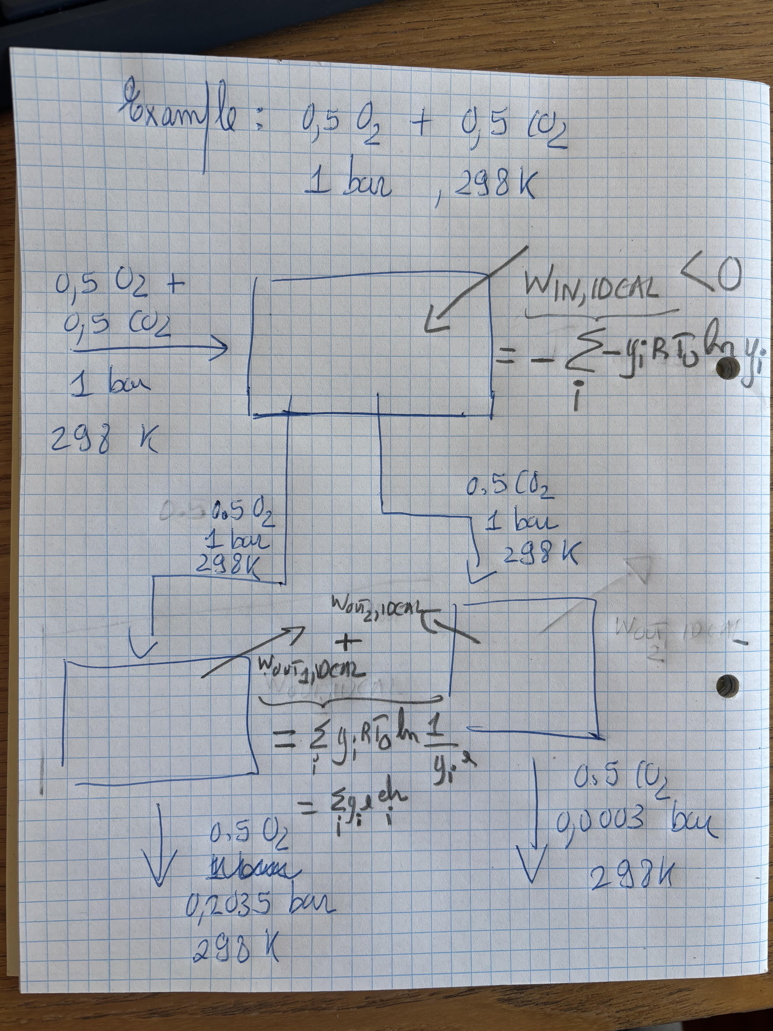

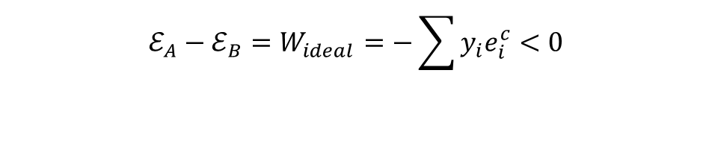

First process: separate the mixture at T₀, P₀ – state B - into “pure” compounds at T₀, P₀ – state C
Work has to be added to the mixture to separate the species
Ideal work (positive if it exits the system) is equal to
Concentration exergy for species i is positive and defined as:
$$ℰ_{A}−ℰ_{B}=W_{ideal}=−∆H+T_{0}∆S≈−T_{0}∆S_{mix}$$
$$ℰ_{A}−ℰ_{B}=W_{ideal}=\sum{y_{i}RT_{0}ln\frac{y_{i}}{1}}<0$$
W_{ideal}<0l
$$e_{i}^{c}=−RT_{0}ln\frac{y_{i}}{1}>0$$
$$ℰ_{A}−ℰ_{B}=W_{ideal}=−\sum{y_{i}e_{i}^{c}}<0$$

Slide 3



Second process: each “pure” compound at T₀, P₀ expands to equilibrium at T₀, P₀
Each“pure” compound at T₀, P₀ expands to equilibrium, doing work on the environment
This value is tabulated as “chemical exergy” (a mis-nomer).
To obtain the chemical exergy for the mixture, we sum chemical exergies of the components, weighted by mole fraction.
$$ℰ_{B}−ℰ_{C}=W_{ideal}=\sum{y_{i}RT_{0}ln\frac{1}{y_{i,0}}}>0$$
W_{ideal}>0l
$$e_{i}^{ch}=RT_{0}ln\frac{1}{y_{i,0}}>0$$
W_{ideal}>0l
$$W_{ ideal}=\sum{y_{i}e_{i}^{ch}}>0$$

Slide 4
Exergy of an ideal Mixture of gases of 0.5O₂ and 0.5 CO₂ at T₀, P₀
Exergy
0.5O₂ at T₀, P₀ & 0.5 CO₂ at T₀, P₀
Ideal mixture 0.5O₂ and 0.5 CO₂ at T₀, P₀
State B
First process where work is added to the gases to separate the components of the mixture
State A
Second process where work is done by the gases on the surroundings
State C
0.5O₂ at T₀, P₀e & 0.5 CO₂ at T₀, P₀e
Reference Environment: Atmosphere
Zero
time

Slide 5
Exergy of an ideal Mixture of gases of 0.5O₂ and 0.5 CO₂ at T₀, P₀
The exergy of the ideal mixture at T₀, P₀ is the sum of ideal works from the previous two steps
The previous expression is the expression used in Thermodynamics textbooks
$$ℰ_{A}−ℰ_{C}=ℰ_{A}=\sum{y_{i}RT_{0}ln\frac{y_{i}}{1}+\sum{y_{i}RT_{0}ln\frac{1}{y_{i,0}^{}}}}=−\sum{y_{i}e_{i}^{c}}+\sum{y_{i}e_{i}^{ch}}$$

Slide 6
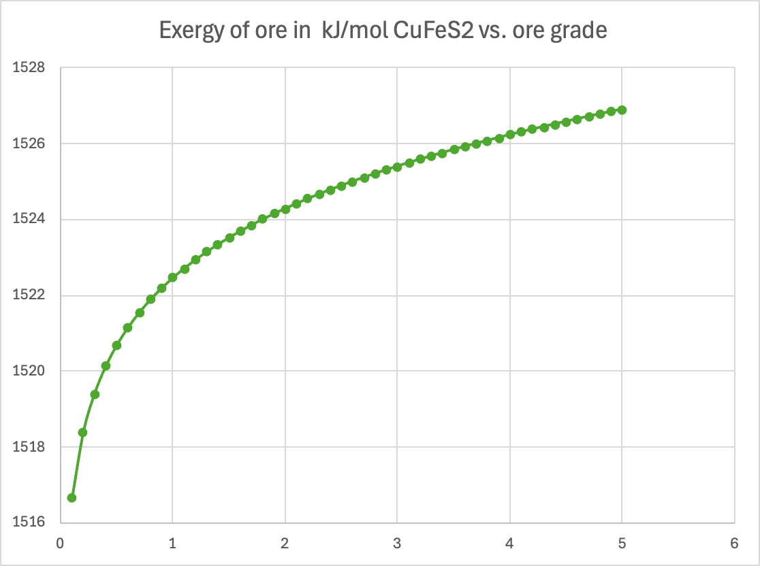
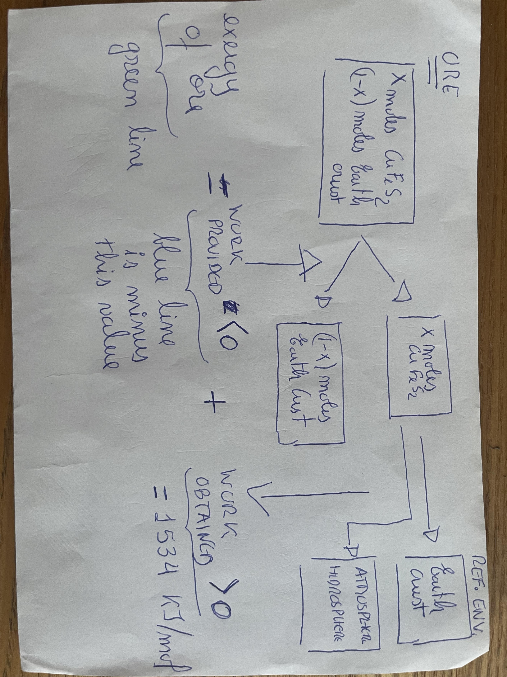
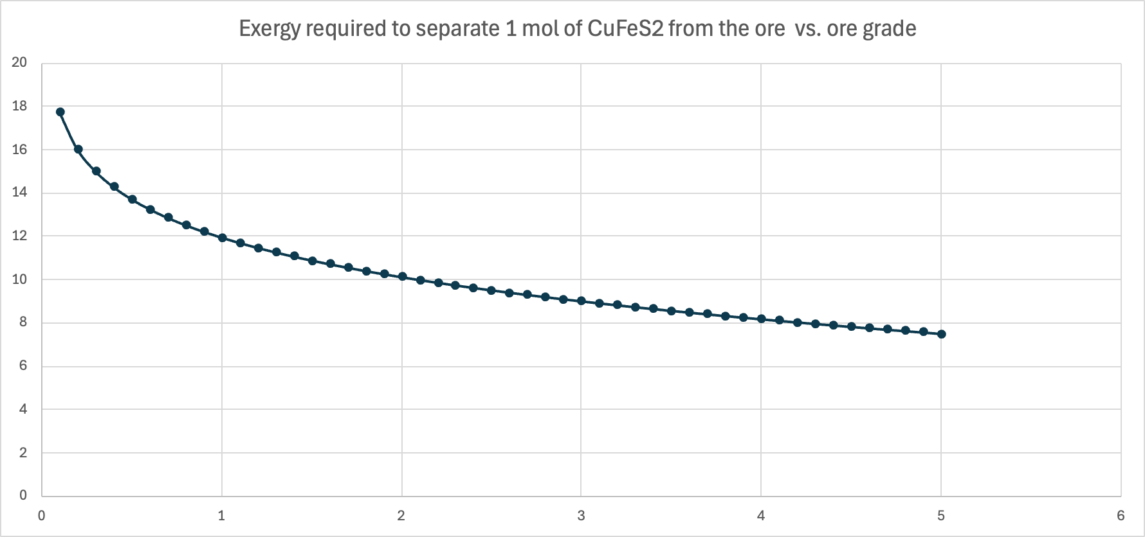
Other example: exergy of ore
kJ/mol
kJ/mol
% Cu mass
W_{ideal}<0l
W_{ideal}>0l
% Cu mass

Slide 7
Exergy of ore
Exergy
First process where work is provided
Second process where work is obtained
Reference Environment: Atmosphere, Thanatia and Ocean
Zero
time

Slide 8
T, P, mixture of species i with y_{i} and d_{i,0}
b_{com} < 0
Reversible process where work is done upon the materials for grinding
T, P, mixture of species i with y_{i} and d_{i}
b_{ph} > 0
Reversible process where work is extracted from the materials
T₀, P₀, pure species i and d_{i,0}
b_{c} < 0
Exergy
Reversible process where work is provided to separate compounds
T₀, P₀, mixture of species i with y_{i} and d_{i,0}
Reversible process where work is extracted in the chemical reactions to equilibrium
b_{ch} > 0
T₀, P₀, species i₀ with y_{i,0} and d_{i,0}
Reference Environments (0): Atmosphere, Thanatia, and Ocean
0

